Slide 1
Review
Software Testing
Dr. Anand Nayyar
Graduate School
Email: anandnayyar@duytan.edu.vn
Cell: 0933622812

Slide 2

Review Lecture 1

Slide 3
Objectives
Explore the knowledge of review, help people understand:
The definition and category of review
The different categories of review
The workflow of inspection (thanh tra, kiểm duyệt)
Testing the specification
Examining the code

Slide 4
Why Review
The most important reason should be that reviewing can save money.
We can test software as early as possible even before software can be run. That means reading the specifications, the designs and the code to find defects.
The other reasons include:
Sharing knowledge
Educating project members
Providing information to make decisions
Gathering information of process improvement

Slide 5
Review effectiveness
Defect detection effectiveness (DDE) of testing activities in SDLC
Activity
Inspection
Informal review
Unit test (no CC target)
System test
Typical Yield
45-70%
20-40%
15-50%
25-55%
General industry data
From CC2E by McConnell, 2004
Notes:
From study in Code Complete, 2nd Edition, pg. 470
Issue rates do not rise above 75% for any single technique
Most techniques average about 40%
Most organizations use test-heavy issue detection and do not rise above 85% issue removal efficiency
But… issue-detection methods work better in combination than they do singly.
Steve McConnell’s story on writing Code Complete 2nd Edition:
First edition of Code Complete was reviewed multiple times by Steve, reviewers, copy editor, technical editor, and proofreader.
Book was in print for > 10 years and readers still sent ~200 corrections
When writing CC2, Steve and reviewers spent time inspecting the first edition to see what needed addressing in the second edition
Formal inspection found several hundred errors in the first edition that had not been previously detected through any of the numerous review activities

Slide 6
What Is A Review
Definition
An evaluation of software element or project status to ascertain discrepancies from planned results to recommended improvements.
Categories of reviews:
Inspection
Team review
Walkthrough
Pair-programming
Peer review
Ad Hoc / Buddy check

Slide 7
The Categories of Reviews
The difference lies in the formality level.
Inspection is the most formal one, then team review, walkthrough, peer desk check and Ad hoc review being the least formal approach.
The more formal the method is, the more defects we will find.
But more formal reviews also cost more.
Least rigorous
Most Rigorous
More agile
Lots of process
Ad hoc
review
Pair
programming
Team review
Peer review
Walk-through
Inspection
Notes:
Ad hoc review: Two developers get together to track down a bug
Very quick; grab first person you can find
Desk check: the author and one other person examine the work item
Usually fairly quick; do not require a scheduled meeting; good if reviewers are skilled at finding issues
Pair Programming: part of extreme programming; two authors develop code simultaneously
Every line of code written by two brains; real-time reviews as code is written; requires no process, preparation or documentation; lacks outside perspective
Walkthrough: author describes work item to a group of peers and solicits comments
No defined procedure; no exit criteria; no metrics; do not focus on issues
Team Review: Team gets together to judge suitability of product and identify issues
Lighter inspection; can be some procedure; no specific roles; not super rigorous
Inspection:
Defined procedure; entry and exit criteria; metrics; checklist-based; inspectors are trained; focused on present and future quality; outside perspective
One review type is not necessarily better than the other – they are used for different reasons
Emphasize that the world “formal” is not scary in this case – inspections are a simple process that is easy to pick up.

Slide 8
Categories of reviews
Inspections
Also called a formal inspection
Seven stages: planning, overview meeting, preparation, meeting, rework, follow-up and analysis.
Team Review
Also called a technical review
The process of the team review is similar to an inspection, but no analysis stage is included.

Slide 9
Walkthrough & Peer Desk Check
Walkthrough
Similar to technical review, but with no preparation, follow-up, or analysis stage.
Pair-programming
On-the-fly review by single reviewer
Peer review
Examination by individual reviewer(s).
Ad hoc / Buddy check
Informal feedback from team member.

Slide 10
Choosing the review type
Suggestion
The more important or risky the deliverables to be reviewed are, the more formal of a review should be chosen.
Considering the importance of SRS (Software Requirement Specification), most project teams choose inspection or at least team review as the approach, as more information will be discussed in “Testing the specification.”
Most project teams choose inspection or team review to examine high-level design, low-level design and critical code.
Most project teams choose walkthrough or peer review for examining daily check-ins

Slide 11
Choosing the review type
Select the review based on desired outcome.
Objective | Insp. | Team Review | Walk-through | Pair Prog. | Peer Review
Find issues | X | X |  | X | X
Measure quality | X
Conform to spec | X | X |  | X | X
Collect data | X | X
Educate team | X | X | X | X
Verify bug fix | X | X |  | X | X
Explore alternatives |  |  | X | X
Minimize review cost |  |  |  |  | X

Slide 12
Exercise: Choose the review
Choose the appropriate review type for each given scenario.

Slide 13
Inspection Process
Plan
Overview
Prepare
Meeting
Rework
Follow-up
Analysis
I M P R V E
I M P R V E
I M P R V E

Slide 14
Inspection Roles
Moderator (người điều hành)
The one who keeps discussions on track during the meeting stage and ensures follow-up occurs.
Recorder
The one who writes down problems during the meeting stage.
Inspector (người kiểm duyệt)
Those who examine the deliverables to find defects.
Author
Those who provide deliverables to be reviewed

Slide 15
Inspection Rules
Some important rules that must be applied:
1. Author shouldn’t act as moderator, reader or recorder.
2. Moderator shouldn’t act as recorder.
3. Keep the inspection team small:3-7 participants will be better.
4. Inspectors should be sensitive to colleagues.
5. The goal of meeting is to find problems not to solve problems.
6. It should take no more than 2 hours to have the meeting.
7. At the meeting, the inspection team should keep a suitable speed : 150-200 SLOC/hour or 3-4 pages/hour

Slide 16
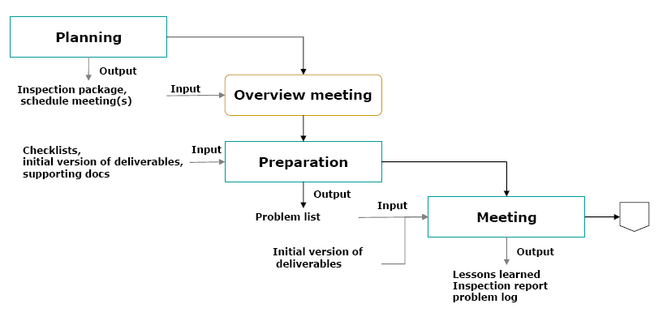
Workflow of Inspection

Slide 17
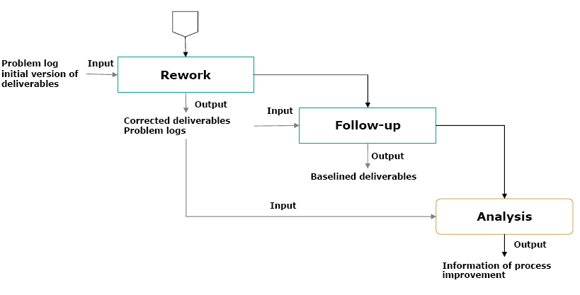
Workflow of Inspection

Slide 18
Inspection Process - Planning
Ensure quality bar for work item has been met
Work item complete
Work item meets team standards
Code compiles (no syntax errors)
Static validation tool analysis complete
Schedule overview meeting (optional)
Schedule review meeting
Plan → Overview → Prepare → Meeting→ Rework → Follow-up → Analysis
Notes:
The “Gatekeeper” is anyone on the team (usually more senior) that has the knowledge to judge a work item for quality
TSP requires 2 inspectors (in addition to the author)
May get higher yields with 3 or 4 inspectors, but increased cost (effort) may not be worth the additional yield
Do what works for your group – if yields are good with 2 inspectors, continue with that.
LocStudio started practicing TSP with 3 inspectors plus author. Later when personal review quality improved, dropped to two inspectors optionally depending on design complexity
The overview meeting is not strictly necessary
Use an overview meeting if at least one of the inspectors is not familiar with the details of the work item being inspected
The inspection meeting may be booked after the overview meeting once all inspectors have been consulted regarding required preparation time
Tip: schedule the meeting up front and then update it later – this commits everyone to a date and exceptions can be dealt with accordingly by sending updates to the meeting request
Using the same people across all deliverables for a feature reduces the need for overviews, and improves the succession/backup potential.
There must be an initial quality bar in place prior to inspecting the work item
Perhaps some level of code coverage with testing, unit tests checked-in
The gatekeeper ensures the quality bar has been met
Helps prevent wasting other people’s time if the material is not quite ready
There must be a definition on a team for what it means for a work item to be “done”
Part of that definition should involve no open issues or bad assumptions
Work item meets team standards
E.g. coding style, document template satisified
TSP recommends that reviews be done prior to compiling code
There is a correlation between the number of compiler errors and the number of actual issues
Encourages developers to be more careful, but…
Do not want developers focusing on the wrong issues in an inspection – let tools do their job
Intellisense is usually running in the VS IDE environment, so the compiler is automatically running
OACR is running on many machines, which does validation checking in the background requiring an app that compiles successfully
Precludes TDD, which is used for design and quality improvements.
TDD says that test should be written and fail (requires compile), code is written, compiled and then successfully passes the test.
Want to encourage devs to do TDD, and the review-before-compile practice gets in the way
Printed materials
Work items do not have to be printed, but there are advantages
Studies have shown that when developers do reviews on screen their yields are consistently low (TSP)
Ensures everyone inspecting identical synchronized work items
Line numbers provide a synchronization point for everyone in the meeting
Frees you from the distractions of the computer (like e-mail)
Landscape mode for code allows for longer lines and provides people space to write
Supporting materials allow inspectors to get a more complete picture of the work item being inspected
Team checklists
Requirements/Design document(s)
Reference materials (e.g. API, UML cheat sheet)
Dependency information
Team coding standards

Slide 19
Inspection Process - Overview
Summarize focus of inspection and prioritize
Security, privacy, functional, etc
Walk-through background materials and work item
Spec overview, solution, etc.
Team agrees on focus and assignments
Each person assigned area of focus
Plan → Overview → Prepare → Meeting→ Rework → Follow-up → Analysis

Slide 20
Inspection Process - Prepare
Is the solution complete?
Is there anything missing?
Check every assumption
Tip: Turn off e-mail and block off time on calendar to avoid interruptions
Plan → Overview → Prepare → Meeting→ Rework → Follow-up → Analysis

Slide 21
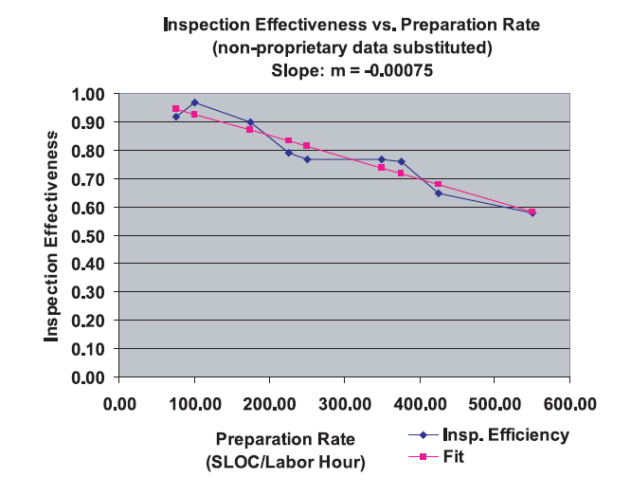
Inspection Process - Prepare
Targeted inspections may allow for more work items to be inspected and slightly higher preparation rates
Plan → Overview → Prepare → Meeting→ Rework → Follow-up → Analysis
Work Item | Recommended Rate
Requirements | 2 – 5 pages/hr
Design | 3 - 5 pages/hr
Code | 200 – 400 LOC/hr
From TSP by Humphrey, 2000

Slide 22
Inspection Process - Meeting
Choose moderator to run the meeting
Choose recorder to enter the data into spreadsheet
Collect preparation and issue data from all inspectors
Enter each issue found and by whom
Classify each issue as major or minor
Decide on outcome of inspection
Accept, accept with minor changes, accept with gatekeeper approval, or re-inspect
Plan → Overview → Prepare → Meeting→ Rework → Follow-up → Analysis
Notes:
If less than half the planned for preparation time has occurred, reschedule the meeting until people are properly prepared
What can the author do to ensure that inspectors are really prepared?
Inject issues
Insert a couple of fairly obvious issues into work item
Place descriptions of issues in sealed envelope in middle of table during overview and inspection meeting
At end of inspection, open envelope
Ensure all inspectors found the injected issues
Also encourages a bit of competition and fun

Slide 23
Inspection Process - Meeting
How do you avoid controversy in an inspection?
No discussion of solutions
Ask questions instead of making assertions
Questions are less confrontational
Your assertion may not really be an issue
Help author reach your conclusion
Do not attack the author
Be aware of cultural differences
Plan → Overview → Prepare → Meeting→ Rework → Follow-up → Analysis

Slide 24
Inspection Process - Rework
Bugs entered into defect tracking software (optional)
Author addresses each and every major issue
Author fixes similar issues elsewhere
Author addresses minor issues (as necessary)
Author researches “investigate” issues and communicates result
Plan → Overview → Prepare → Meeting→ Rework → Follow-up → Analysis

Slide 25
Inspection Process – Follow up
Gatekeeper ensures all major issues found during inspection have been addressed
Re-inspection scheduled (if necessary)
All bugs from inspection are resolved
Gatekeeper ensures all exit criteria satisfied and closes the inspection
Plan → Overview → Prepare → Meeting→ Rework → Follow-up → Analysis
Notes:
If inspection participants do not feel their issues are being addressed, their motivation to participate in inspections may diminish.
Author can go back to sheet and add comments where necessary if an issue will not be addressed; also, clear with gatekeeper
Another activity may involve setting up a process improvement meeting to discuss the details of the items identified during the collection stage of the inspection process.

Slide 26
Inspection Process - Analysis
Do you know if review is effective?
Basic rule—An inspection is effective if:
Inspectors found a similar number of issues
Each inspector found the same issues
Measure, measure, measure!
Plan → Overview → Prepare → Meeting→ Rework → Follow-up → Analysis
Notes:
At the end of an inspection meeting, you need to know whether you should accept the work item or reinspect (among other things). Here are some rules around judging effectiveness
E.g. if 3 inspectors perform a code inspection and find the same 20 issues, intuition tells us that most of the issues have probably been found. However, if they find varying numbers of bugs with very few in common, the smoke is probably indicating a fire

Slide 27
Inspection Process - Analysis
Issue detection efficiency
Issues per unit time
Issue detection effectiveness
Issues per KLOC
True yield
Percentage of issues found in inspection vs. total (including test)
Estimated cost savings
Time per issue * # issues – time reviewing
Plan → Overview → Prepare → Meeting→ Rework → Follow-up → Analysis

Slide 28
Inspection Process - Analysis
Identify why something happened to prevent recurrence
Brainstorm problems based on issue list
Brainstorm solutions to the problems
Treat the problem instead of the symptom
Continue to ask, “Why?” (the five whys) until reaching a reasonable cause
Plan → Overview → Prepare → Meeting→ Rework → Follow-up → Analysis
Notes:
Root cause analysis, RCA, is a methodology with which to analyze a problem or set of “undesirable events” to lead back to an initial, or “root”, cause. The goal of the “root cause analysis” study is not necessarily to find the root cause, it is to find a solution that eradicates the undesired event by eliminating the reoccurrence of the problem.
Problems identified during inspection or with tools may simply be minor human error
E.g. a specific bug, lack of inspection effectiveness
RCA identifies why something happened – getting to the root-cause of the correction helps lead to process improvement such that the problem is prevented from reoccurring
Use hard data to determine which issues require root-cause analysis
Ask “why?” until you get to the bottom of the issue
What type of design issue? Simple mistake, requirements, bad assumptions?
If requirements, why was the problem not caught sooner?
Is there a gap in the development process? Is there a gap in technical knowledge?
EEH = Engineering Excellence Handbook for your team
Address the highest impact issues first (Pareto principle)
"80% of the benefit is due to 20% of the cost" A.K.A. the 80/20 rule.
The trick, of course, is figuring out which 20%.

Slide 29
Inspection Process - Analysis
Consider corrective actions that:
Prevent an error from (re)occurring at the source
Are within your control
Are cost-effective
Are within your goals and objectives
No unacceptable side-effects
Prevents similar occurrences
Cost-effective
Plan → Overview → Prepare → Meeting→ Rework → Follow-up → Analysis
Notes:
When considering corrective actions, they should be as cost-effective as possible to implement
May not mean completely solving the problem at hand, but being able to detect it earlier and fix it earlier in the cycle instead of a bug getting all the way through to the test phas

Slide 30
Inspection Process - Analysis
Improving inspections
Update team standards
Update or create checklists
Update engineering manuals
Update/develop tools to proactively catch issues
Get training
Improve communication
Inspect related pieces
Plan → Overview → Prepare → Meeting→ Rework → Follow-up → Analysis
Notes:
Make sure you fully analyze how bugs got through the defenses for high priority issues
RCA may lead to the rest of the activities on this list
Consider:
Checklists and document templates
E.g. a particular problem like not checking input parameters is frequently-occurring. The stop-gap measure is to update the checklist, but also ensure developers know why this is important and the team standard of how to do it.
Inspection process, if there is a problem with inspection effectiveness
Look for other areas in the product that may exhibit the same issues
E.g. have not been having an overview meeting with a walkthrough so people are not seeing the big picture), so add an overview
Development process (EEH), if something is getting in the way of early cycle quality – E.g. not running automated tools prior to inspection so institute process to run the tools; E.g. need a documented check-in process so create a checklist
Tools, if problems are easily detectable via automated tools
Develop an add-in that finds frequent errors your team makes
E.g. feed updates to PREfast, PREfix, PREsharp and FxCop team
Team standards
E.g. the team is excessively catching all exceptions and sinking the error
Coding standards, design standards, etc. should be updated to proactively prevent frequent errors
Good for new members of the team to prevent previously made mistakes
Training program, if the team is lacking a particular skill, such as design
E.g. there is no common vocabulary across the team for design, such as UML notation so put devs through training
Communication: check-in mails, document notification, change process helps people stay in tune with changes
Team communication practices, if communication is a root cause
E.g. there are team communication issues where requirements are not being fed from PM to development in a timely and complete fashion causing development to guess at certain issues

Slide 31
Key points
Plan a project for reviews
Don’t skip at crunch time
Participate in reviews
Reviews only work if you add value
Prepare before the meeting
Don’t show up unprepared
Drive closure on action items
Fix bugs, follow up
Measure effectiveness
How do you know your team is improving?

Slide 32
High-Level Specification Review
Objectives
Find specific defects such as large fundamental problems, oversights, omissions, etc.
Can use the following techniques:
Put yourself in the user’s shoes: meeting the user needs is what quality means.
Research existing standards and guidelines.
Review and test similar software.

Slide 33
High-Level Specification Review
If you are a user
Examining the specification from the customer perspective, you can ask yourself the following questions…. if I was the customer:
1. What functions do I need?
2. Are all the functions I need included in the specification?
3. Are there functions conflicting with the former ones?
4. Are the functions easy to use?
5. How about the performance?
6. Are the functions secure?
etc
Gaining some familiarity with the field in which the software applies, would be a great help.

Slide 34
High-Level Specification Review
Existing research standards and guidelines
Testers may refer to the existing standards and guidelines when performing high-level reviews of specifications.
Following are some of them:
1. Organization standards, terminology and conventions: software should adopt the common terms and conventions used by the end users.
2. Industry standards: In some industries there are strict standards that software must follow.
3. Government standards.
4. Security standards.
etc
Testers should consider the relative standards as part of the specifications.
When reviewing the specification, testers should test whether the correct standards are being used and none is overlooked.

Slide 35
High-Level Specification Review
Review and test similar software
Nothing is better than hands-on experience. You can get useful information from similar software. This could be:
1. Former versions of your software
2. Similar software of your organization
3. Competitors’ products
When reviewing similar software, you may pay attention to the following questions and think about whether this will impact your testing.
1. Will there be more or less features?
2. How about the scale of code?
3. Will your software be more or less complex?
4. How about testability?
5. How about the performance, security and other non-functional attributes?

Slide 36
Low-Level Specification Review
Attributes of a good specification
Complete: Is anything missing?
Accurate: Is the proposed solution correct? Does it properly define the goal?
Unambiguous: Is the description precise and not vague? Does everyone agree on the interpretation? Is it easy to understand?
Consistent: Does it conflict with other features?
Relevant: Is the information in the spec important?
Feasible: Can the feature be implemented with available resources?
Notes:
Precise, Unambiguous and Clear: Is the description exact and not
vague? Is there a single interpretation? Is it easy to read and
understand?
Rõ ràng và trong sáng: là mô tả chính xác và không mơ hồ? Có một giải thích duy nhất? Là nó dễ đọc và dễ hiểu không

Slide 37
Low-Level Specification Review
A Good specification has the following attributes:
Code-free: Does the specification stick with defining the product and not the underlying software design, architecture and code.
Testable: Can the feature be tested? Is enough information provided that a tester could create tests to verify its operation?
When examining the specification, you can ask yourself if the words and pictures you are reviewing have these attributes.

Slide 38
Low-Level Specification Review
List of problem words
When examining the specification, pay more attention to the following words and the context that are ambiguous or unclear. There are chances that they may lead to defects.
1. Always, Every, All, None, Never: these words denote something as certain or absolute. Make sure that it is, otherwise think of cases which violate them.
2. Certainly, Therefore, Clearly, Obviously, Evidently: these words tend to persuade you into accepting something. Please think about it carefully.
Notes:
ambiguous : mơ hồ, khả nghi
denote : chứng tỏ, biểu thị
violate : vi phạm
Certainly, Therefore, Clearly, Obviously, Evidently:Chắc chắn, Vì vậy, rõ ràng, Hiển nhiên, Rõ ràng
words tend to persuade you into accepting something : có xu hương thuyêt phục....

Slide 39
Low-Level Specification Review
List of problem words
3. Some, Sometimes, Often, Usually, Ordinarily, Customarily, Most, Mostly, Etc. And so forth, And so on, Such As, Good, Fast, Cheap, Efficient, Small, Stable: these word aren’t testable. They must be further defined to explain exactly what they mean
4. Handled, Processed, Rejected, Skipped, Eliminated: these words may hide functionality which should be specified.
5. If…then: the statements miss else clause.

Slide 40
Key points
Put yourself in the shoes of the customer
Question “problem words” and ask for clarification
The spec is a planning document
Try to get it as complete as possible from the start
Realize it is not “cut in stone”

Slide 41
Code reviews
A code review is a process identifying potential errors by examining source code before bugs are introduced into the program.
Reviewers read the code to check for:
Flaws or potential flaws
Consistency with the overall program design
The quality of comments
Adherence to coding standards.
Familiarity – is it easily testable
Testability

Slide 42
Exercise: Code reviews
Formality of code reviews vary depending on several factors
E.g. risk, code complexity, etc.
List each factor on a sticky note and place along line corresponding with type of review
Least rigorous
Most Rigorous
Team review
Peer review
Walk-through

Slide 43
Code Reviews
Entry criteria for review
Solution is complete and logic is sound
Code compiles
Static analysis violations resolved
Team coding standards met
Unit tests complete and pass on private build
Personal review for obvious errors
Notes:
A personal review involves a line-by-line analysis of the code to ensure it meets quality standards and there are no obvious errors
Use your personal checklist to ensure all frequent mistakes have been addressed
TSP recommends a personal review on printed code – not on the computer where distractions occur
Coding standards
Gatekeepr should ensure that the code meets the team standards before involving other inspectors in the process
Some say to do inspections before compiling the code
Statistical correlation to number of compile problems to number of issues in code
Points to developer “sloppiness”.
Can be a worthy challenge with benefits (cleanroom)
But don’t waste time finding issues that tools are good at finding
Some say to do inspections before running unit tests
Harder to debug test failures via unit testing than via inspection
People might hesitate to inspect a module that has already been tested and “works”
May help flag more tests
But…
Unit tests can help understand the code
Unit tests allow changes to code identified from inspection to be made easier
But then would need a separate inspection to look at unit tests, which requires a context switch
Might make more sense if some external entity (not the developer author) is writing the tests, but that is not what we advocate

Slide 44
Tools
Coding standards & guidelines
Checklist
Static analysis tools

Slide 45
Coding Standards and Guidelines
Standards and guidelines are collections of best experience of programming.
Help when coding and examining the code.
Improves consistency throughout team
Reduces long term maintenance costs
Helps reduce certain classes of bugs

Slide 46
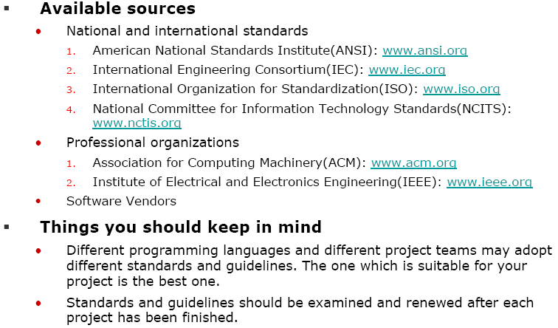
Where Can Standards Be Obtained

Slide 47
Checklists
Checklists help remind us
Personal checklist: frequent mistakes
Team checklist: common mistakes
Characteristics of a good checklist
Brief sentences
Number of items on the checklist manageable
Fits on 1 or 2 pages
Concentrate on major issues; not all
Updateable by team
Supporting documentation
Notes:
How many people use checklists for their regular day-to-day activities? Why?
Checklists
Team checklists used for inspection focus
Personal checklists used for personal review
Start with your most-frequently made mistakes
As mistakes are consistently corrected, remove from checklist and replace with other items
Checklist are useful throughout all phases of the development cycle, but particularly for code where there is much to remember

Slide 48
Checklist
Always use a checklist for reviewers to refer to when examining the code.
Does the code satisfies the requests listed in the checklist. If not, it is likely that there are defects.
A segment of a Java Checklist Example (Adopted from Java Conventions: http://java.sun.com/docs/codeconv/CodeConventions.pdf
Checklist example
Code Standard

Slide 49
Managed code analysis tools
Type of analysis
Static analysis
Semantic analysis
Syntactic analysis
Run-time analysis
Logical analysis
Rules analysis (style)
Rules analysis (stds)
Tools
FxCop
Compiler
NUnit
StyleCop,
FxCop
Notes:
INSTRUCTOR: Do not spend much time on this slide
Be aware of the type of issues flagged by each of the tools – do not look for those issues during code inspections!
FxCop analyzes IL, which is basically source level analysis
It can look for certain kinds of issues as well as adherence to the .NET design guidelines
PREsharp is C# source-level static analysis
Can automatically call FxCop
Spec# is an enhanced version of C# that supports design-by-contract constructs
Possible issues are flagged by the compiler, a static analysis tool called Boogie does a more thorough analysis, and code is injected by the compiler to throw exceptions at run-time.
Spec# inserts code automatically to validate the contract at run-time
Spec# also supports checked exceptions
FaultInj injects exceptions into managed code to test error handling at random or specific points of execution
NUnit is a tool to help with the creation of unit tests, which test the logic of the program
StyleCop is a fully customizable coding style analysis engine that flags violations of the configured rules
The Whidbey IDE supports automatic formatting of C# code according to configured conventions

Slide 50
JAVA code analysis tools
Type of analysis
Static analysis
Semantic analysis
Syntactic analysis
Run-time analysis
Logical analysis
Rules analysis (style)
Rules analysis (stds)
Tools
Notes:
INSTRUCTOR: Do not spend much time on this slide
PREfast can do the following:
Do conventional static analysis looking for common programming mistakes
Do semantic analysis using PREfast assertions, which provide support for pre-conditions, post-conditions, invariants and other constructs
Look for custom coding patterns to enforce coding standards
AppVerifier assists developers in quickly finding subtle programming errors that can be extremely difficult to identify with normal application testing.
Makes it easier to create reliable applications by monitoring an application's interaction with the Windows operating system, profiling its use of kernel objects, the registry, the file system, and Win32 APIs (heap, handles, locks, and more).
APIscan ensures that the binaries being scanned call only APIs in the Windows operating system (OS) that have been documented in MSDN

Slide 51
Exercise: Tools vs. Humans
Think about the types of bugs that are typically found in code reviews
List each bug on a sticky note
Put the sticky note on the white board
Humans
Tools

Slide 52
Code review areas of focus
Which problem areas should we focus on during code reviews
Security Reliability/error handling
Testability
Internationalization
Supportability
Documentation Style
Concurrency
Dependency interaction
Performance
Team standards
Missing annotations
Design satisfied Privacy

Slide 53
Key points
We can use reviews to examine software before it is finished.
Reviews can save money.
In software development, we often use peer reviews.
Inspection is the most formal review method and is usually applied when reviewing important deliverables
Focus on substance; not style

